Slide 1
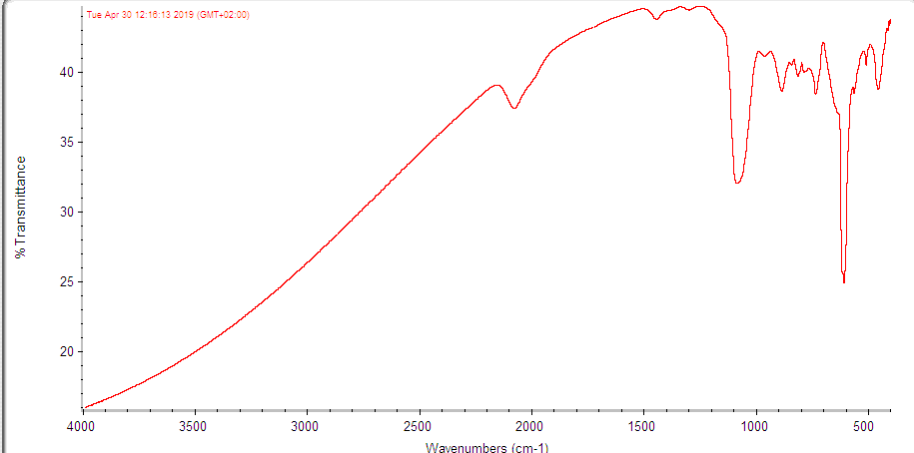
100

Slide 2
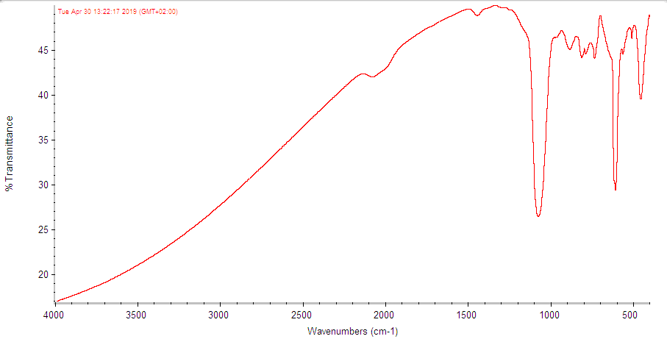
250 (~ 2 hour after HF clean)

Slide 3
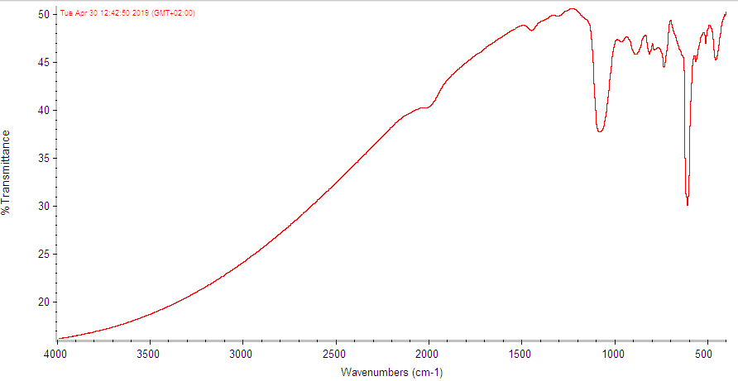
350

Slide 4
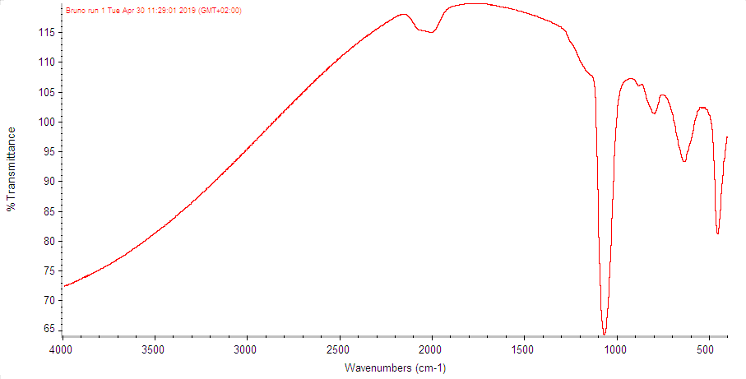
250 (aperture 62 instead of 92)

